Slide 1






Master Thesis Collequim submitted as a partial requirement for the degree of:
M.Eng., Embedded Systems for Mechatronics
Author of the thesis:
Mustafa Özçelikörs
Supervision by:
M.Eng. Robert Höttger,
Prof. Carsten Wolff
Acknowledgements
This work is completed for FH Dortmund IDiAL within APP4MC project as a master thesis project. The project is funded by BMBF Fund.Nb. 01-S14029K under Project AMALTHEA4public. A4MCAR project is also granted by The Eclipse Foundation and Google Inc. during Google Summer of Code 2017.

Slide 2
Contents
Introduction
Overview
Problem and Solution
Motivations
Goals and Contributions
Events and Publications
Parallel Programming Basics
Definitions
Design Techniques
Synchronization
Scheduling Analysis
Optimization
APP4MC
Design and Implementation of A4MCAR
Overall Look
Development Workflow
Basic Infrastructure
Low-level Applications
High-level Applications
Web Interface
Android App
Efforts Toward Tracing
Efforts Toward Software Distribution
Reducing Power Consumption
Results
Distributions
Comparison
Conclusions

Slide 3
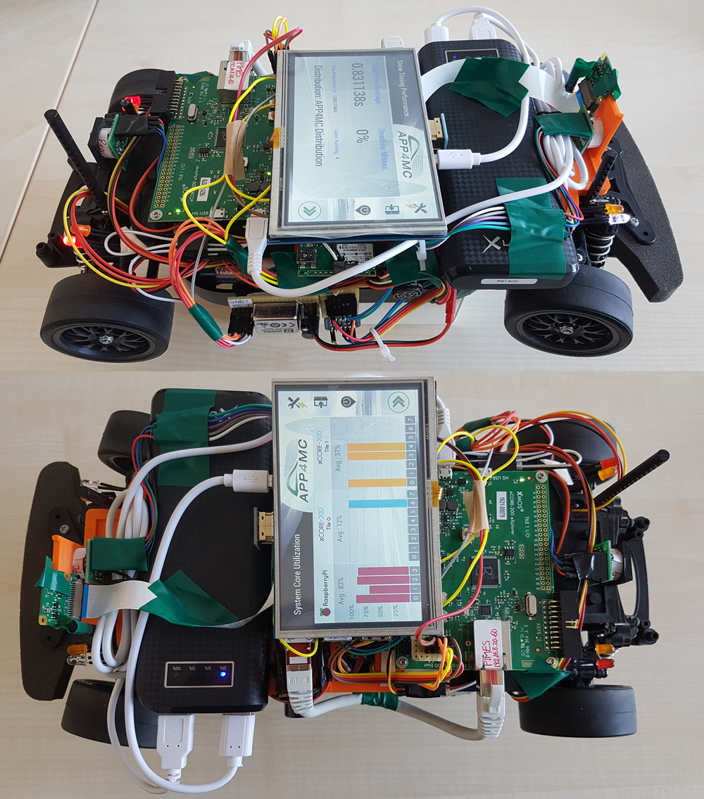
Introduction
Overview
APP4MC
Embedded-multicore system design platform
Automotive domain
Sw deployment through Sw and Hw modeling
A4MCAR
Demonstrator to APP4MC
Features schedulable and traceable software
Has many applications
Problem and Solution
Distribute software efficiently between cores, considering optimization goals
As a solution, APP4MC results are evaluated and presented.

Slide 4


Introduction
Motivations
Evolution of multi-core processors
Evolution of algorithms, applications, and application domains.
Evolution of new trends in parallel computing
Model-based development
Developing open-source!!!

Slide 5
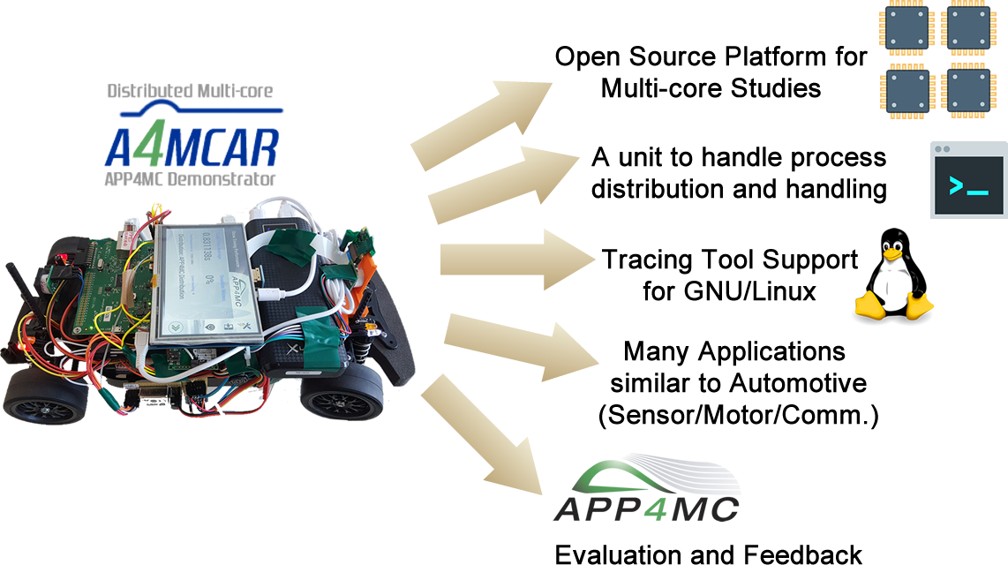
Introduction
Goals and Contributions of A4MCAR

Slide 6




Introduction
Events and Publications
IRC

Slide 7
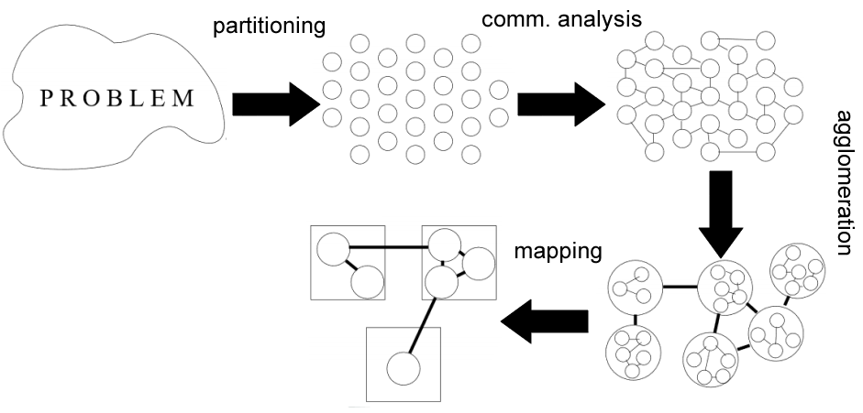
Parallel Programming Basics
Parallel Design

Slide 8
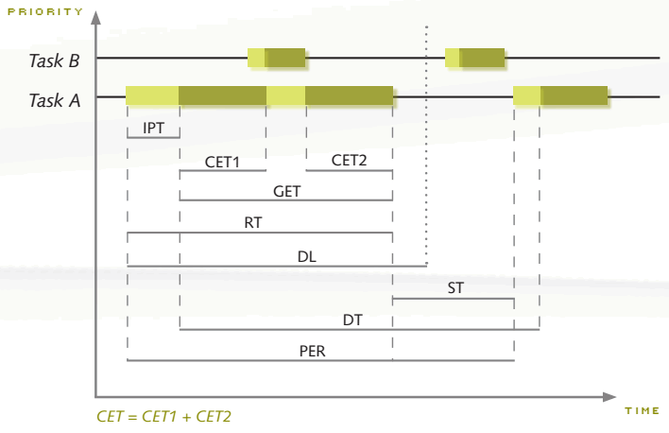
Parallel Programming Basics
Synchronization
Mutex
Semaphores
Scheduling Analysis
Interprocess Communication
Shared memory comm.
Mapped memory
Process semaphores
FIFOs
Pipes
Sockets
used
used
for job queues
used
used
ST, GET, DL, PER

Slide 9
Parallel Programming Basics
Optimization
Goals
Minimizing resouce consumption
Active cores / Timers / Memory
Minimizing computation time
Less overheads / Correct Interdependency
Minimizing power consumption
Active cores / Communication costs / Load balance
Maximizing reliability
Zero deadline misses

Slide 10
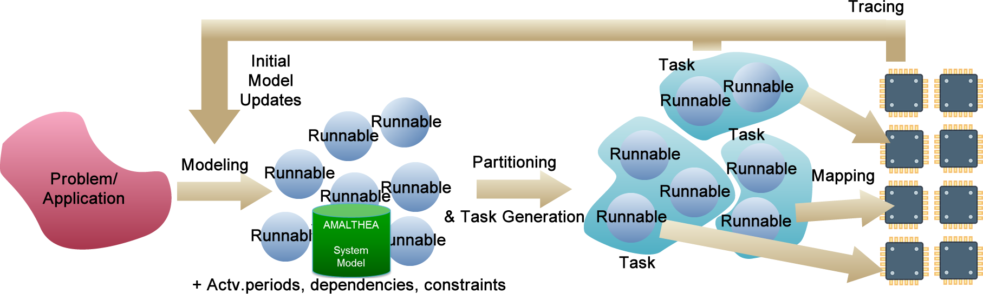
APP4MC
What is APP4MC?
Design Flow with APP4MC
Modeling
AMALTHEA models
Partitioning
ESSP, CPP
Generating Tasks
Mapping
ILP-based, GA-based load balancing
Minimizing computation time
Optimization towards energy consumption
E.M.F

Slide 11
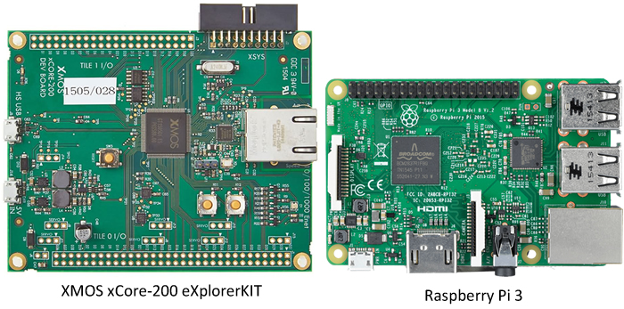
Design and Implementation of A4MCAR
Introduction
Two multi-core controllers
16-core 4-core

Slide 12
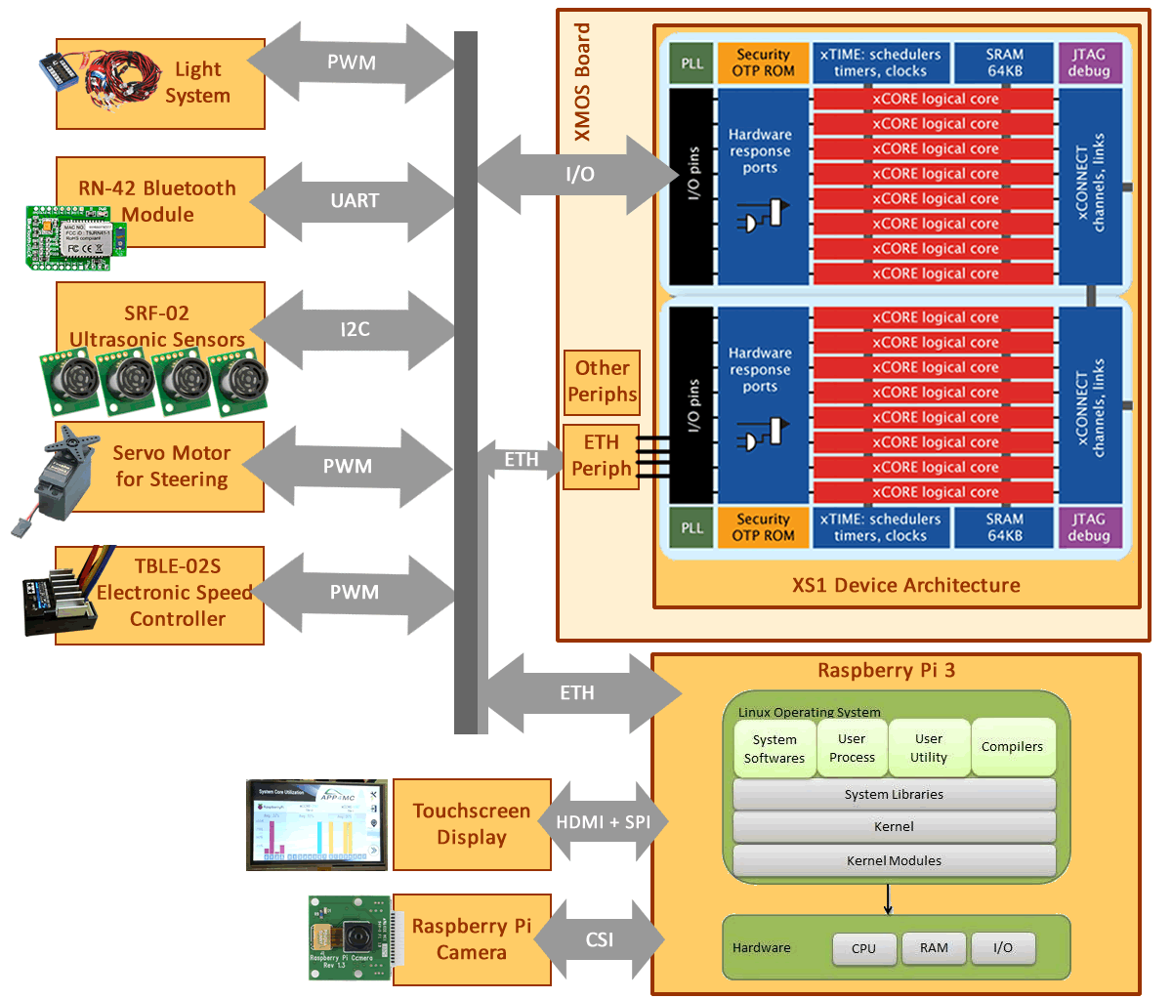
Design and Implementation of A4MCAR
Overall Look to A4MCAR
Hardware

Slide 13
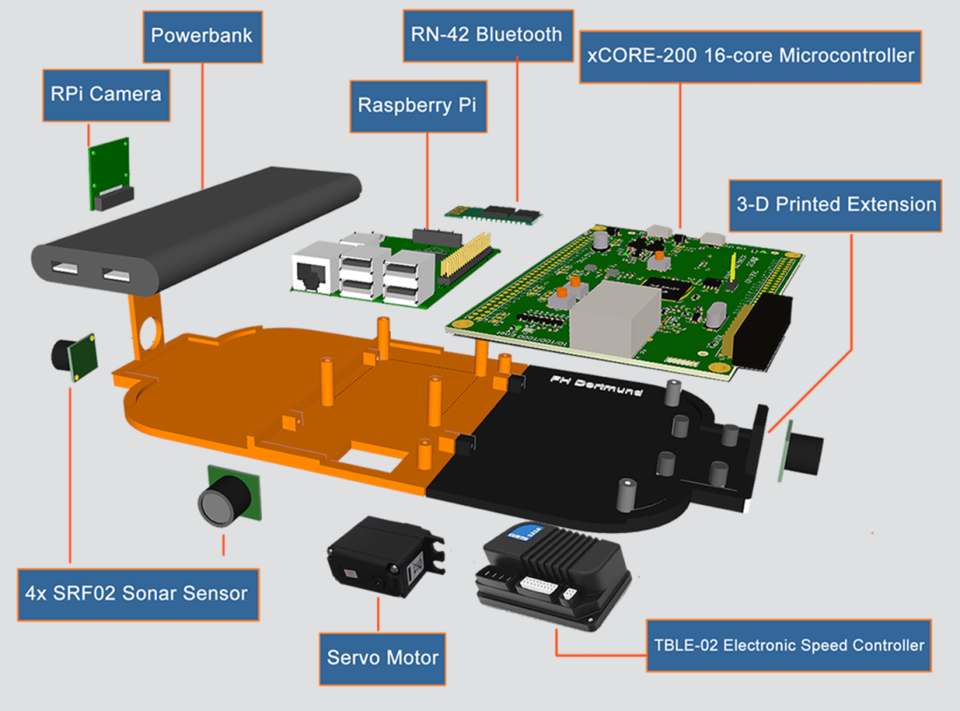

Design and Implementation of A4MCAR
Overall Look to A4MCAR
Mechanical Design

Slide 14
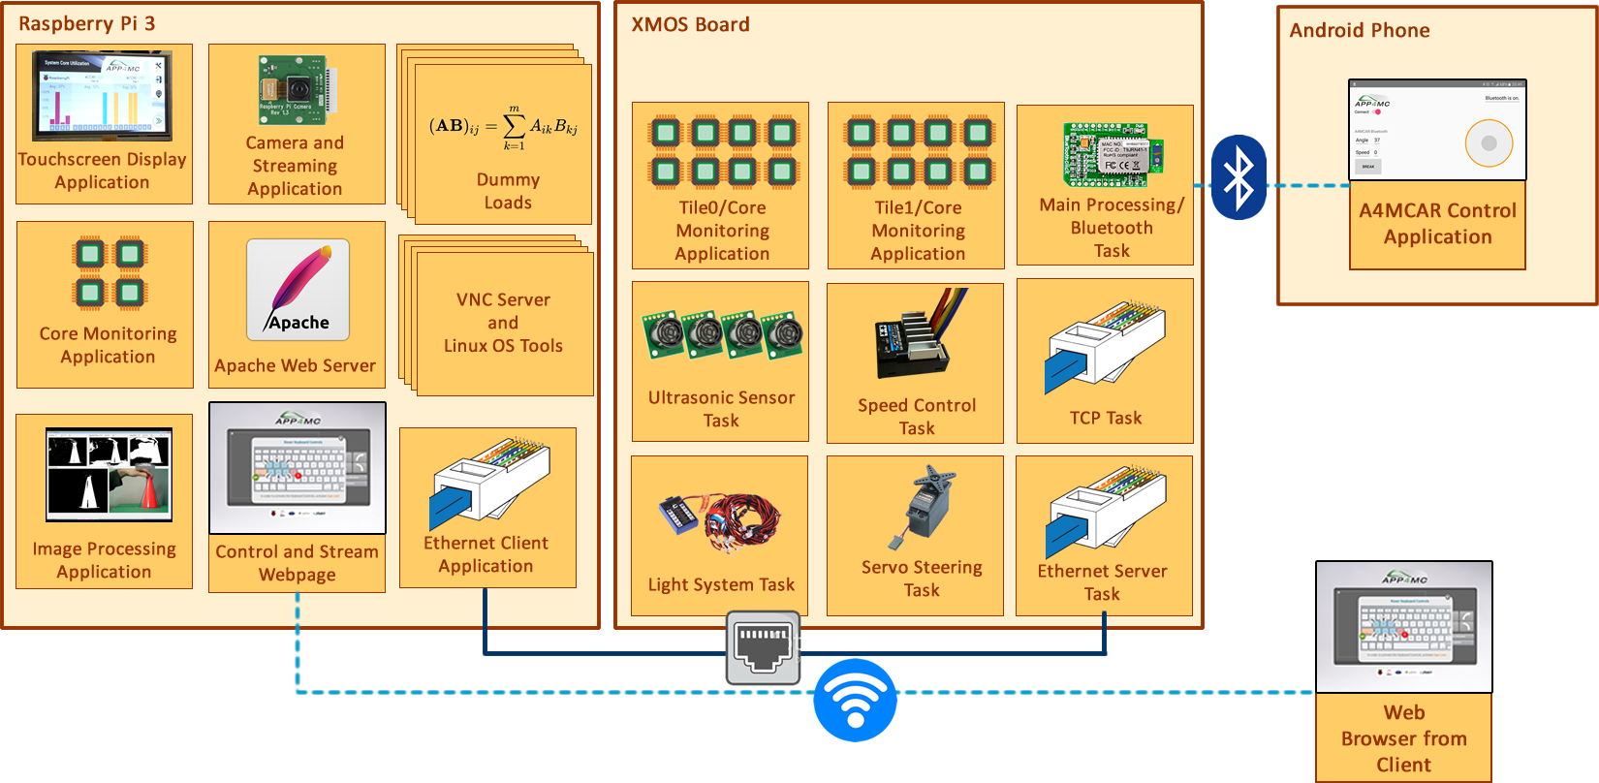
Design and Implementation of A4MCAR
Overall Look to A4MCAR
Software

Slide 15
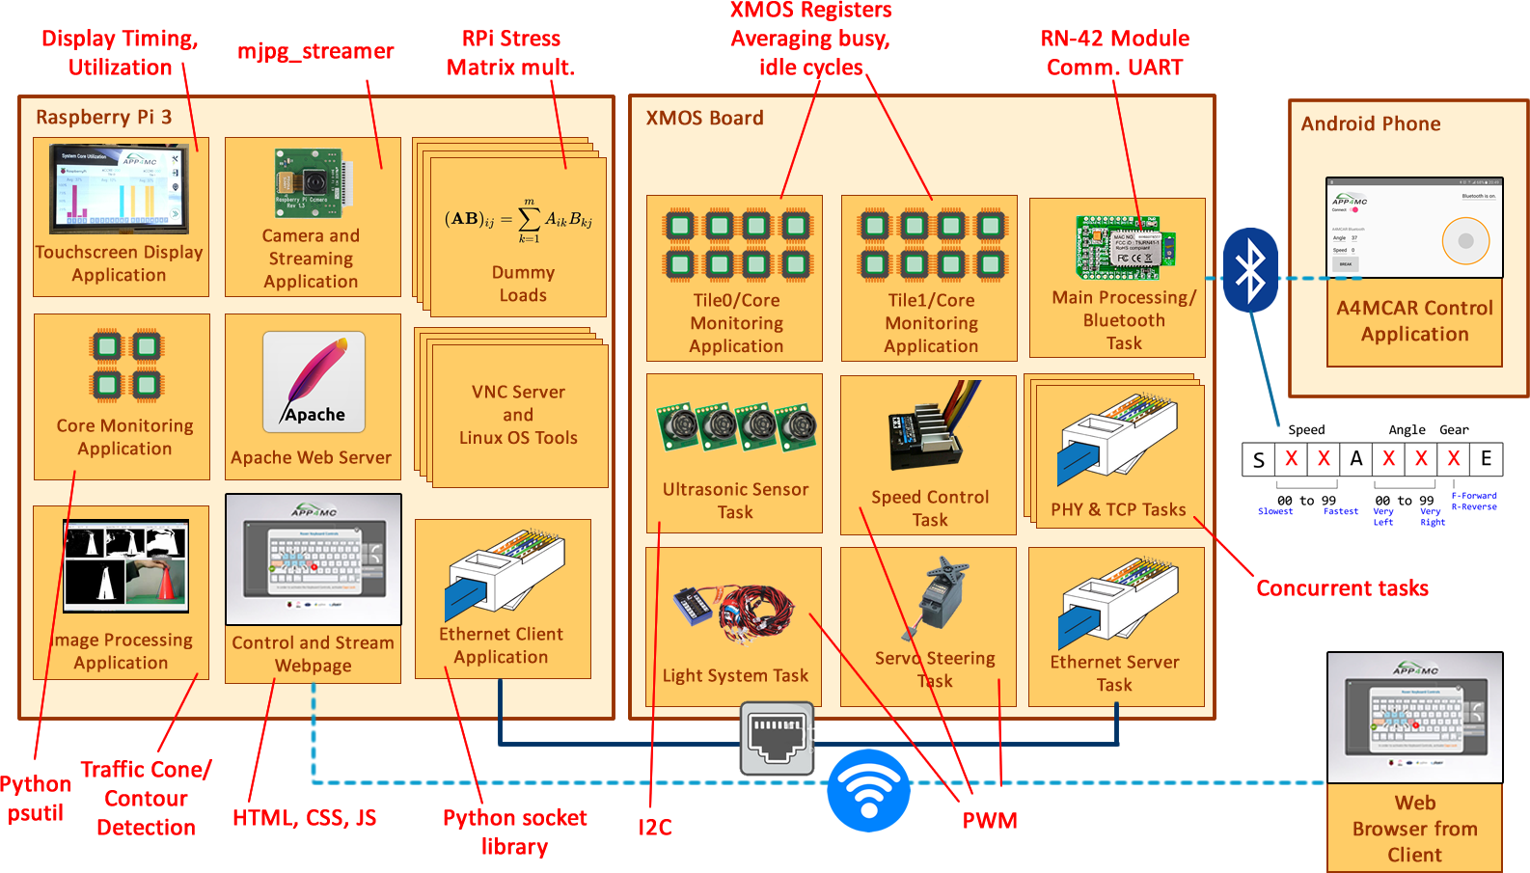
Design and Implementation of A4MCAR

Slide 16
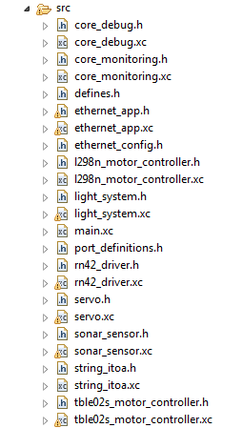
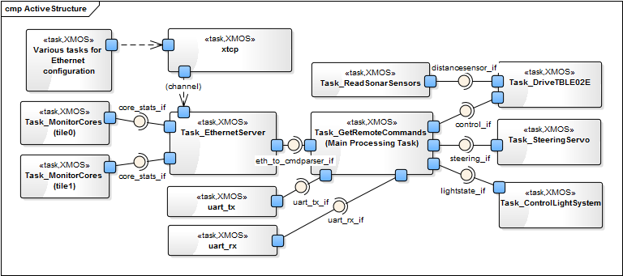
Design and Implementation of A4MCAR
Low-level Module Tasks
Overview

Slide 17
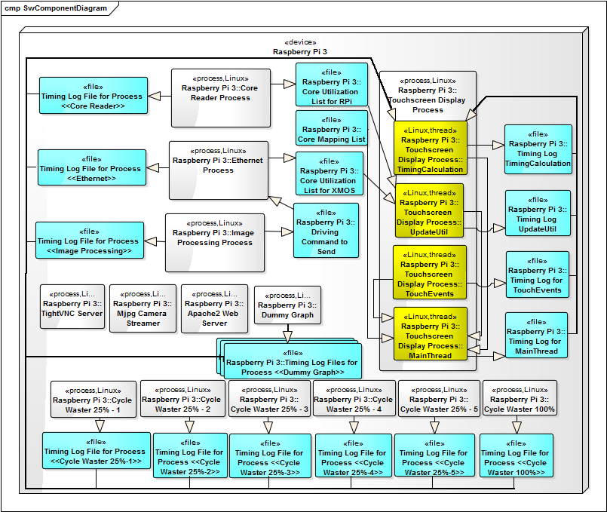
Design and Implementation of A4MCAR
High-level Module Tasks
Overview
Process/threads
Mapped memory
ST,GET,DL,PER

Slide 18
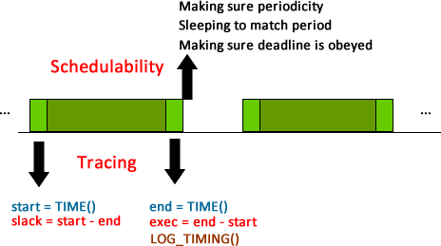
Design and Implementation of A4MCAR
High-level Module Tasks
Overview
Schedulability and traceability (of apps)

Slide 19
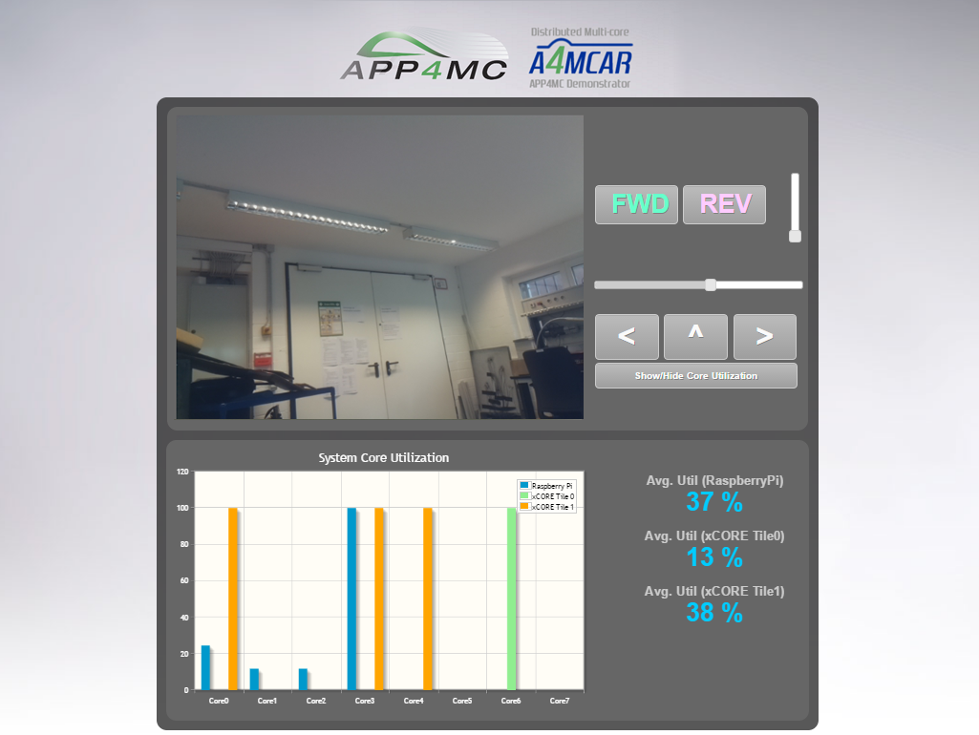
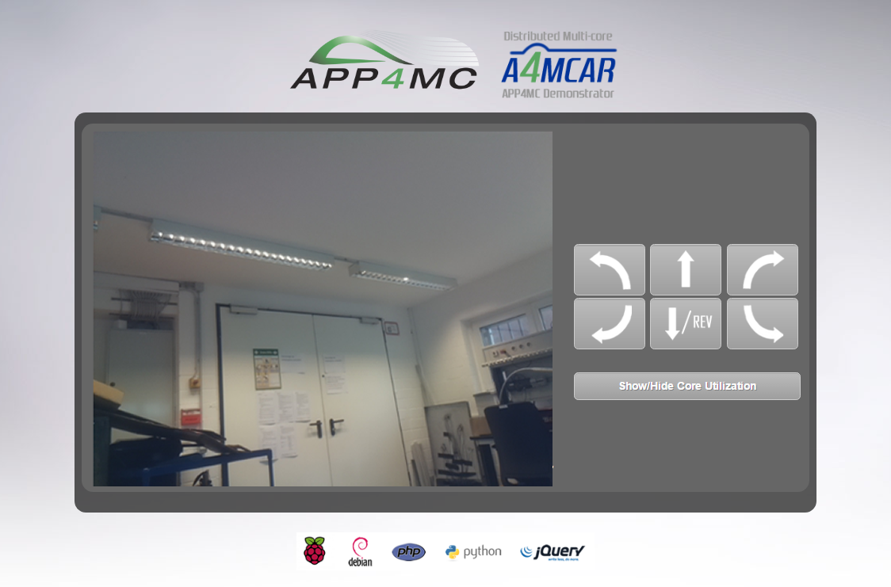
Design and Implementation of A4MCAR
Web Front-End Design and Implementation
Technologies Used: HTML, CSS, PHP, JavaScript, AJAX, jQuery, Python

Slide 20
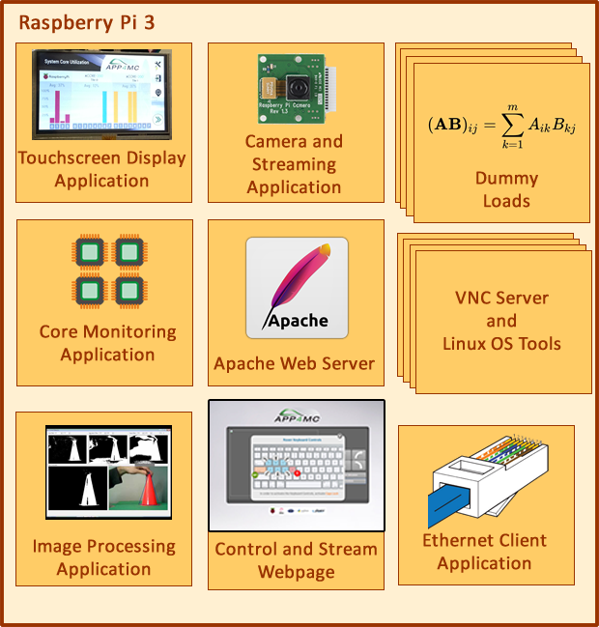
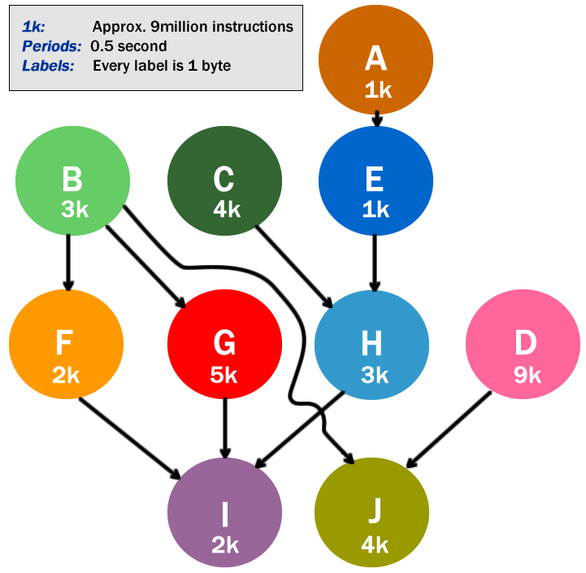
Design and Implementation of A4MCAR
High-level Module Tasks
Dummy Graph
Multi-threaded, 200x200 matrix mult.
To demonstrate “partitioning”
Dummy Loads
Random matrix multiplication 1000 x 1000

Slide 21
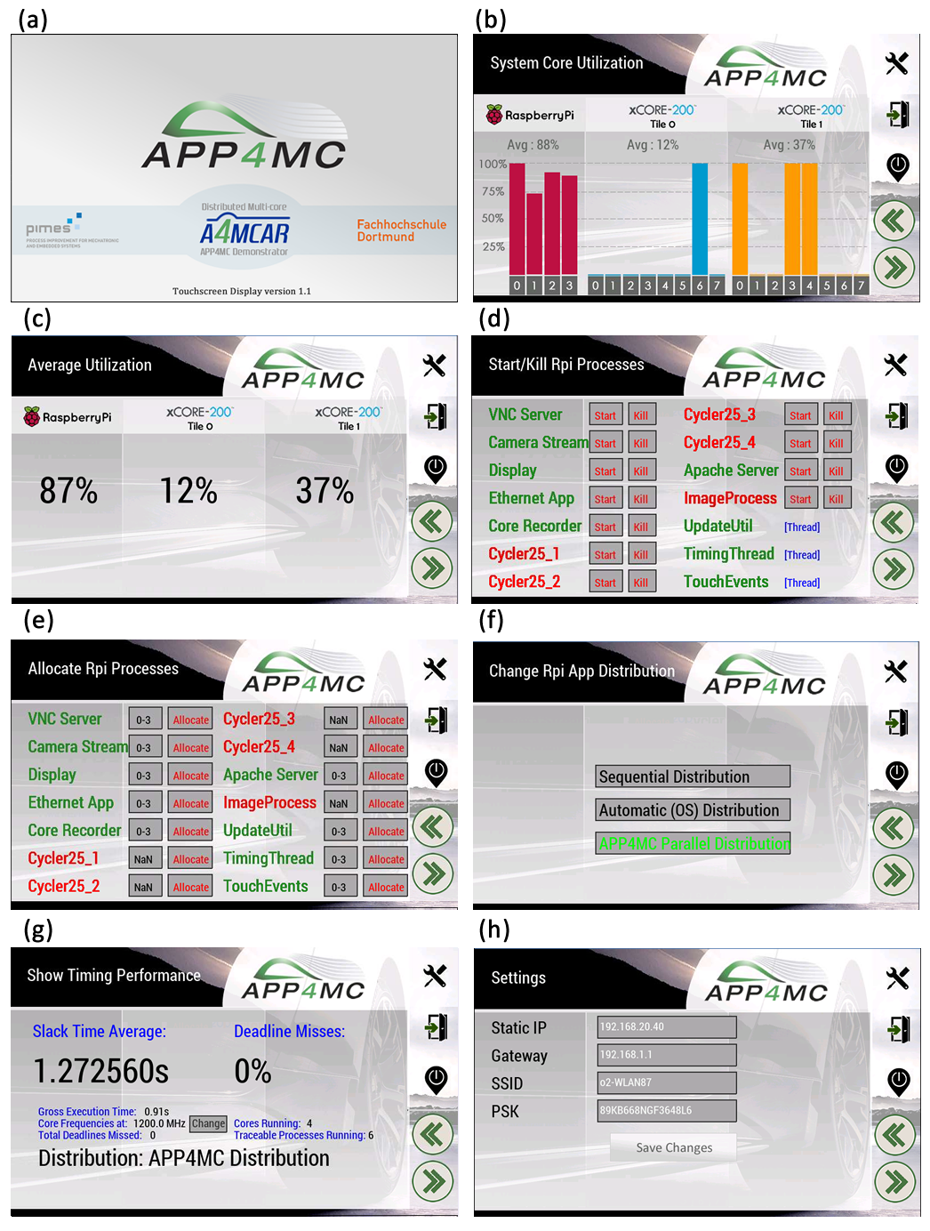
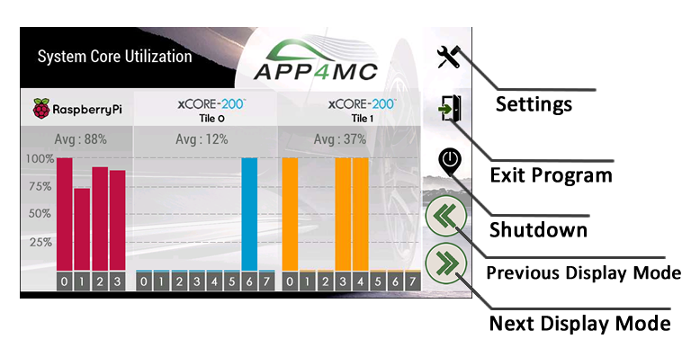
Design and Implementation of A4MCAR
High-level Module Tasks
Touchscreen
HDMI Toucshscreen, pygame

Slide 22
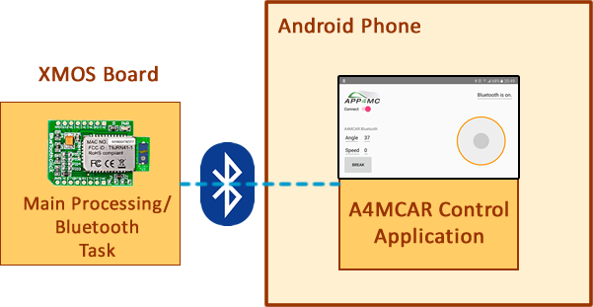
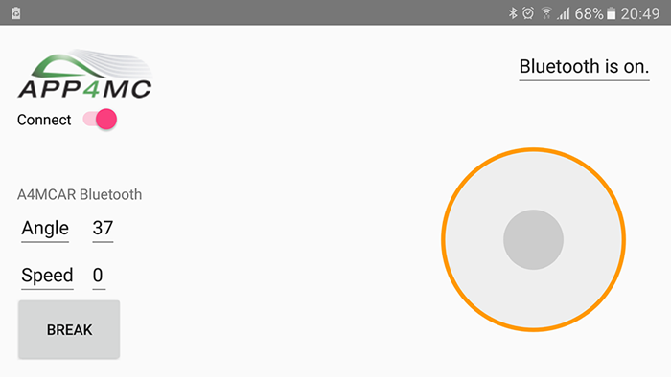
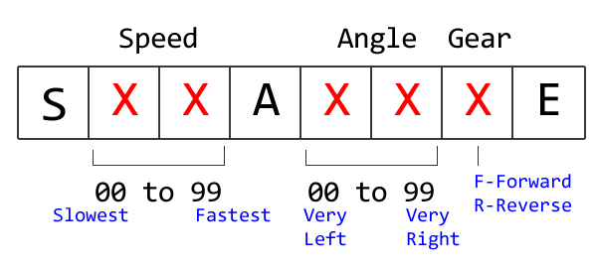
Design and Implementation of A4MCAR

Slide 23
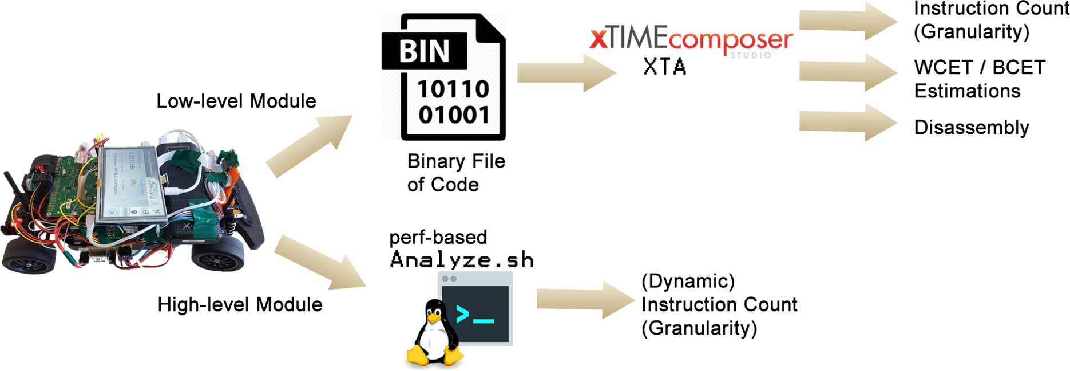
Efforts Toward Tracing
Gathering Information
to Model with AMALTHEA
(Nondeterministic tasks result in ‘Unresolved’)

Slide 24
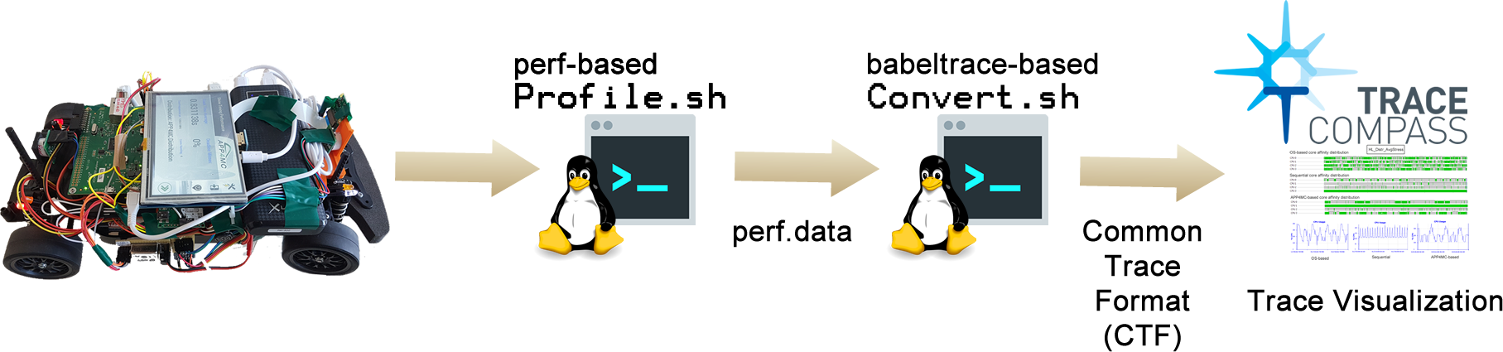
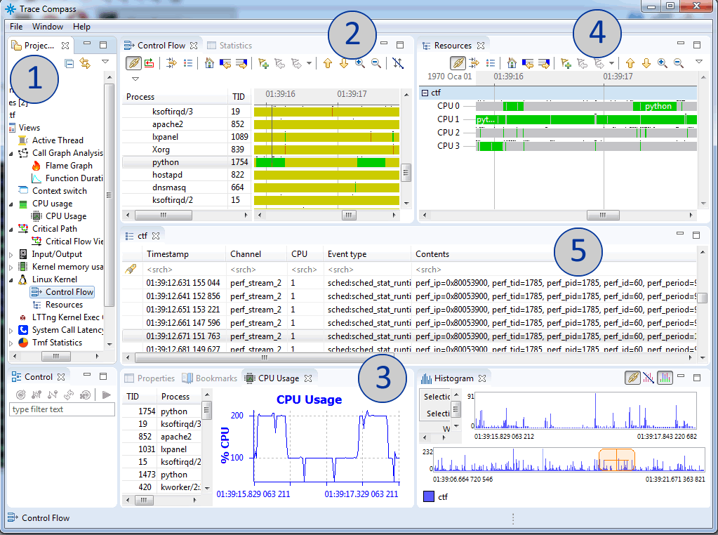
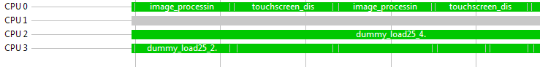
Efforts Toward Tracing
Obtaining/Visualizing System Traces

Slide 25
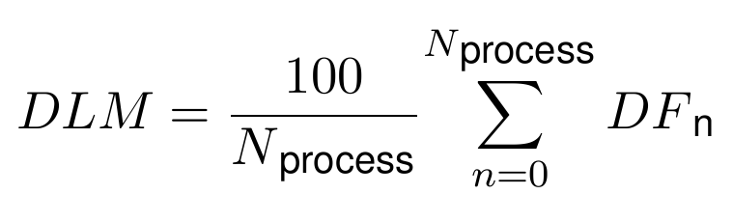
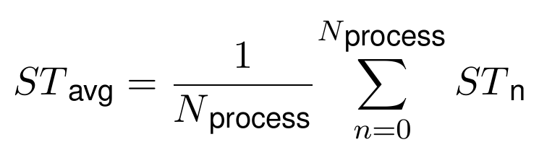
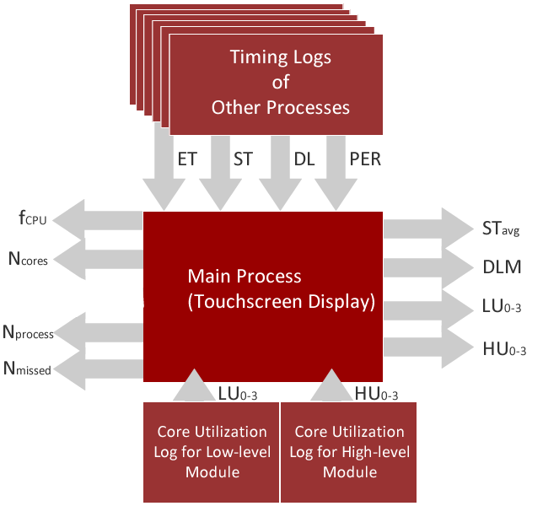
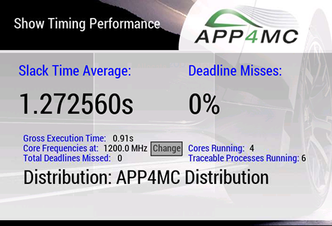
Efforts Toward Tracing
Implementations regarding
evaluation metrics

Slide 26
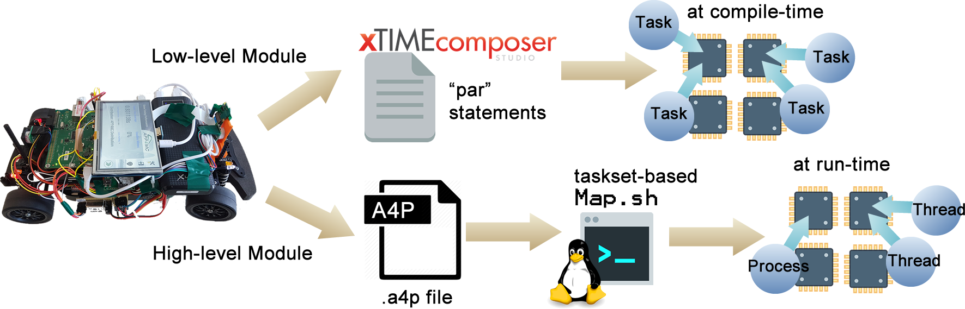
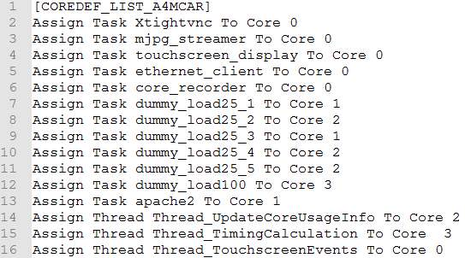
Efforts Toward Software Distribution

Slide 27
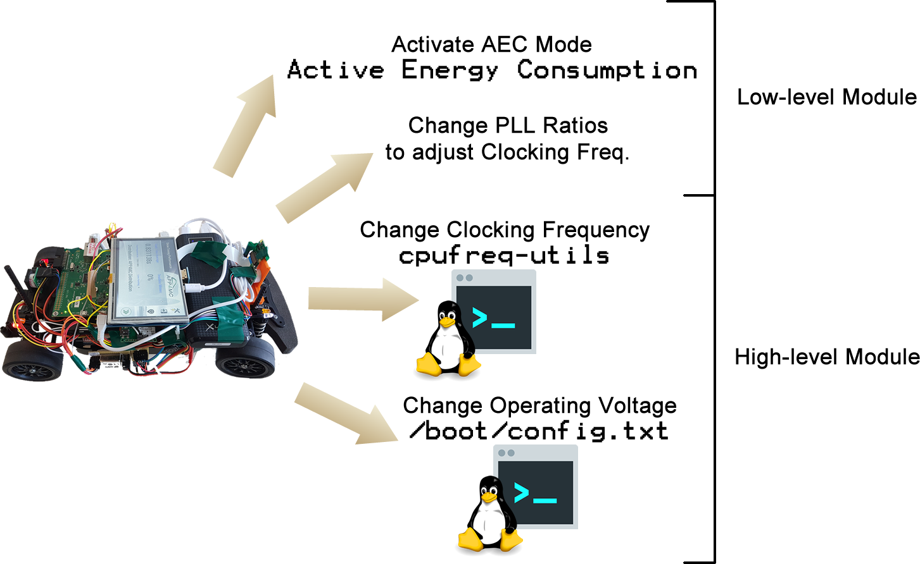
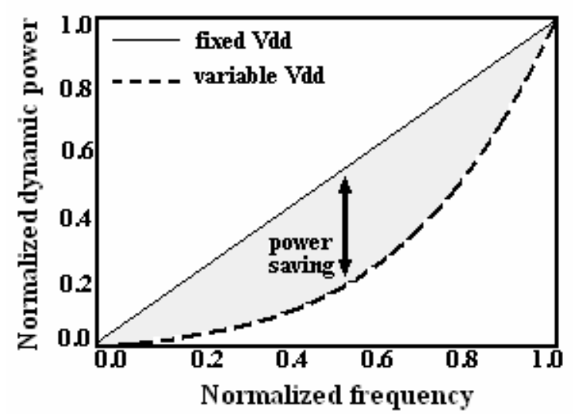
Reducing Power Consumption

Slide 28
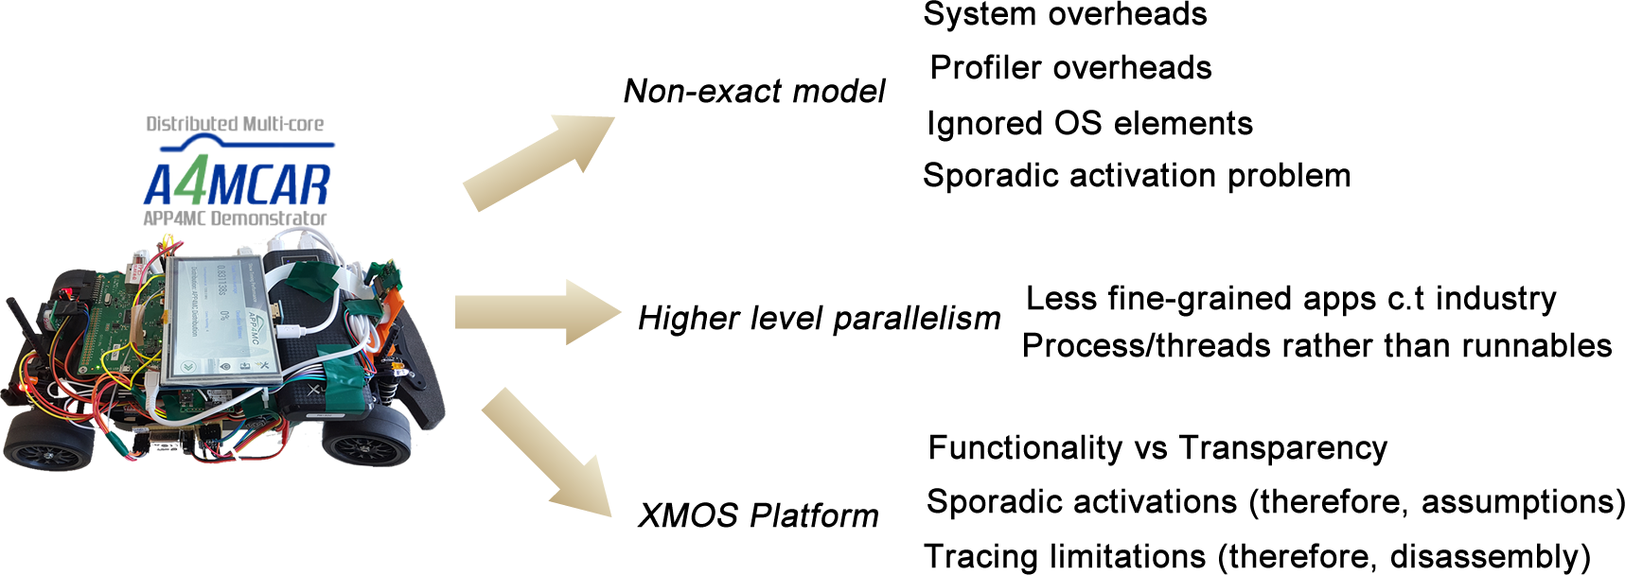
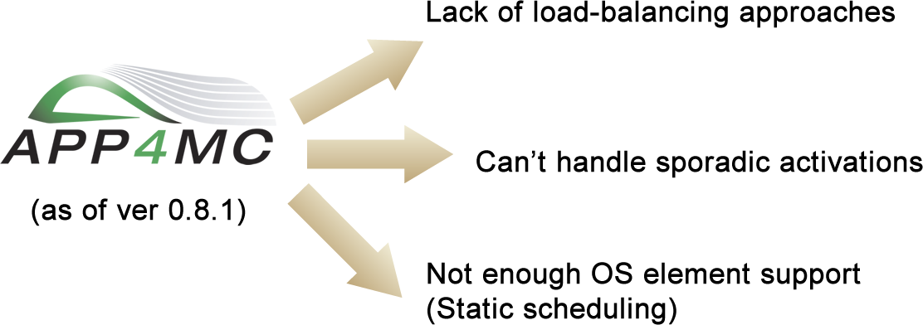
Results
Limitations and Constrains
Notes:
Non-exact model
Profiling errors and overheads (perf), System overheads (5%), Invisible OS elements
Sporadic activations are not allowed in APP4MC. Therefore, assumptions are involved.
Strict dependencies in APP4MC’s Partitioning
OS does not ensure dependencies, while APP4MC ensures it.
More dependency-loose bin-packing algorithms are now being developed.
Static scheduling approach
APP4MC -> static scheduling approach, OS -> dynamic scheduling, migration involved
XMOS hardware and tooling limitations
Unresolvable sections of code.
Disassembly counting involved.
Core Utilization tracing using registers are only valid for periodic tasks, and are non-exact.
XMOS Application Functionality vs Transparency
Using third party libraries make it harder to have a traceable, distributable system.
Load-balancing limitations of APP4MC
Partitioning algorithms use activation-dependent grouping
Mapping algorithms focuses on reducing max. Computation time.
New approaches will consider n-stage algorithms to also consider load-balancing.

Slide 29
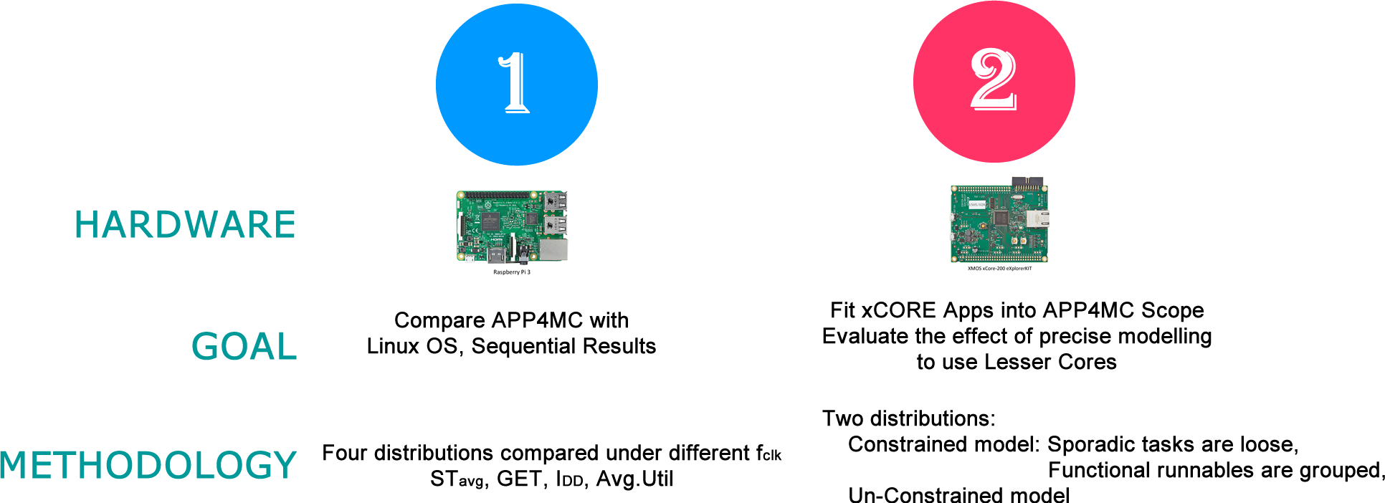
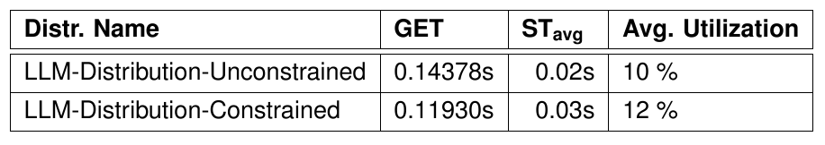
Results
Stability problems
Notes:
Evaluation goal: To fit xCORE applications into APP4MC scope
Parallelization goal = # of cores required exceeded.
Approach = periodic tasks are distributed, sporadic tasks are left undistributed.
For evaluation GET and STavg is calculated, Avg.Util is observed.
For XMOS, APP4MC model needs to be constrained.
i.e. Sporadic tasks are not distributed.
i.e. Functional runnables need to be grouped together.
Otherwise the functionality issues are observed in the distribution execution.
Constrained model gave better timing performance.

Slide 30
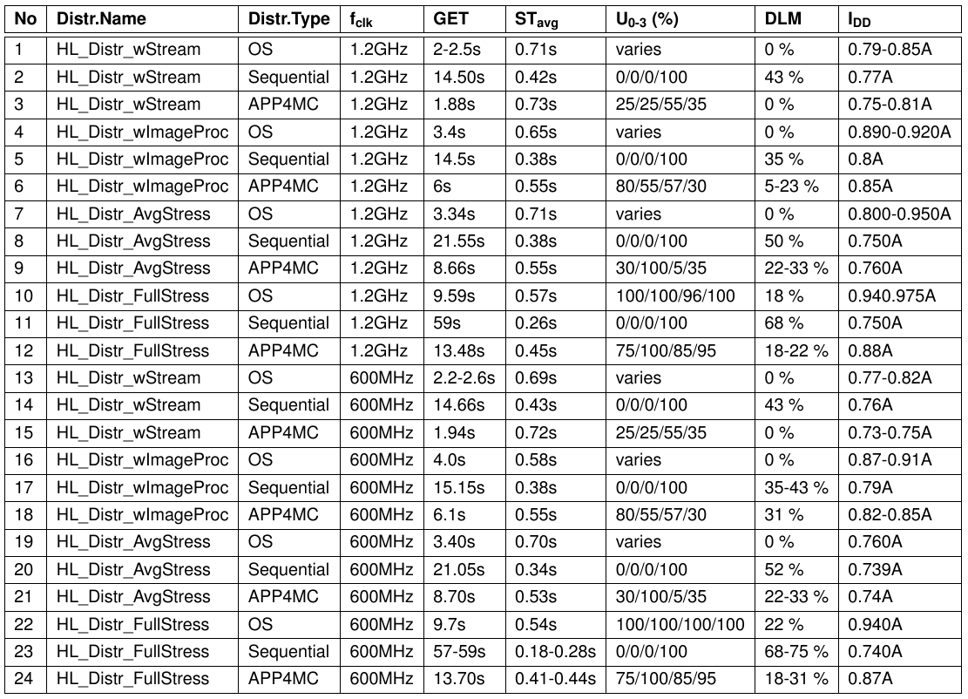
Results
HL Comparison &Evaluation

Slide 31
Results
HL Comparison &Evaluation
Worse
For
APP4MC

Slide 32
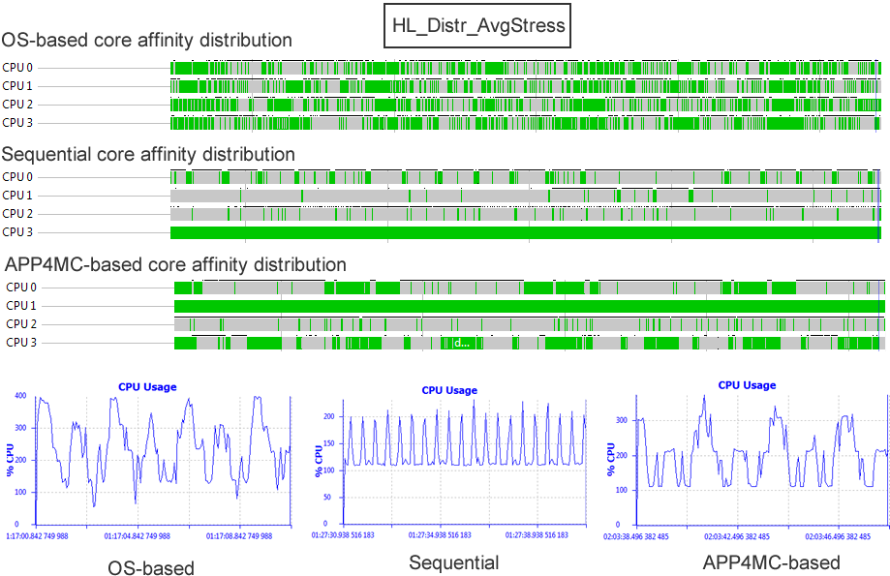
Results
Traces (from Eclipse TraceCompass)

Slide 33

Results
HL Comparison &Evaluation
Best
For
APP4MC

Slide 34
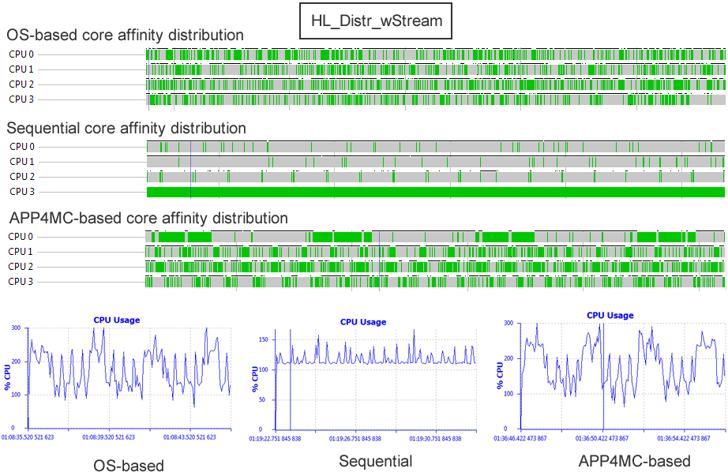
Results
Traces (from Eclipse TraceCompass)

Slide 35
Results
HL Comparison &Evaluation
Slight Gain
in Power Cons.

Slide 36
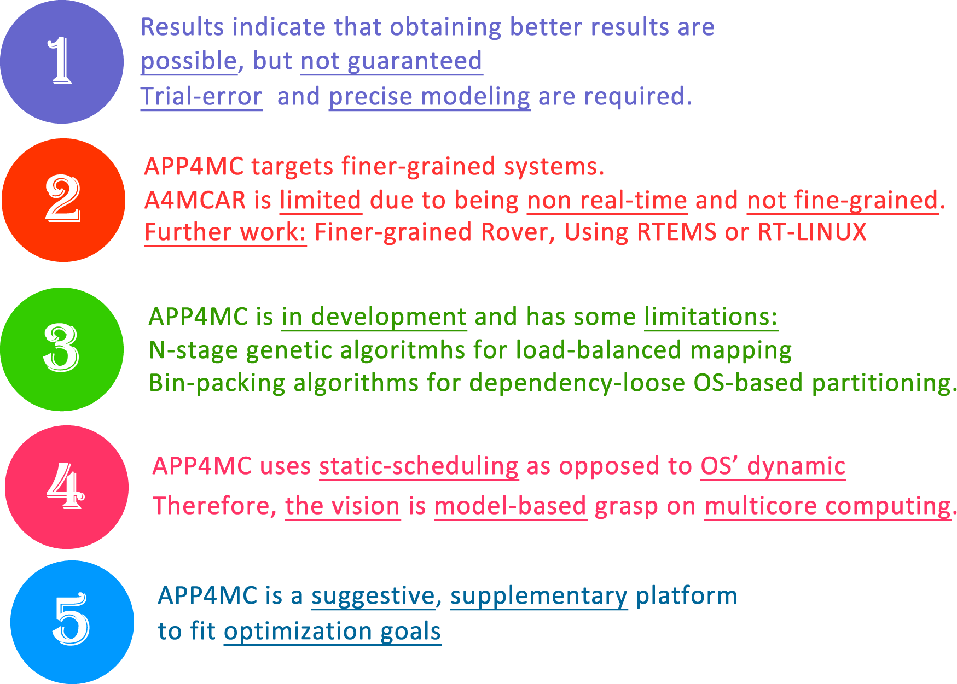
Conclusions

Slide 37
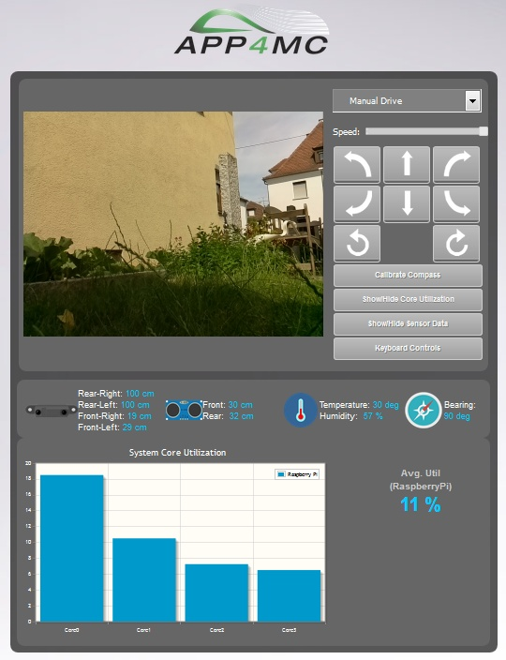
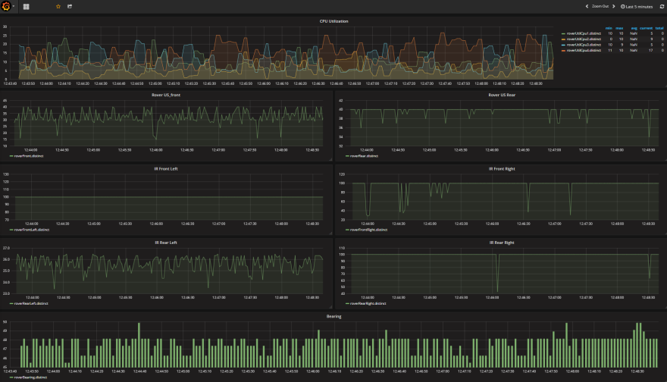
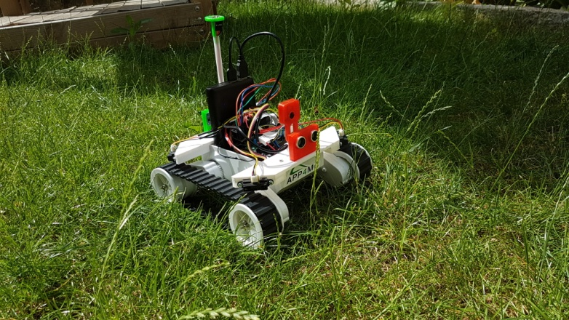
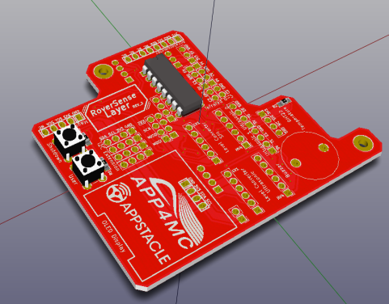
Further Work
Finer-grained apps
Uniform software
Real-time kernel patches (if required)
Cloud interaction
Automotive-HMI developments
More sensors & custom PCB

Slide 38
Thanks for Your Attention ! - Demo and Questions -

Slide 39
-- Auxillary Slides --

Slide 40
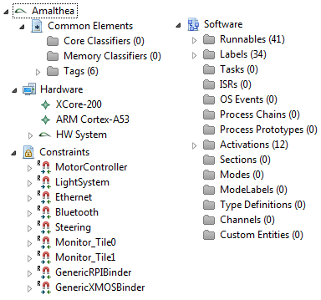
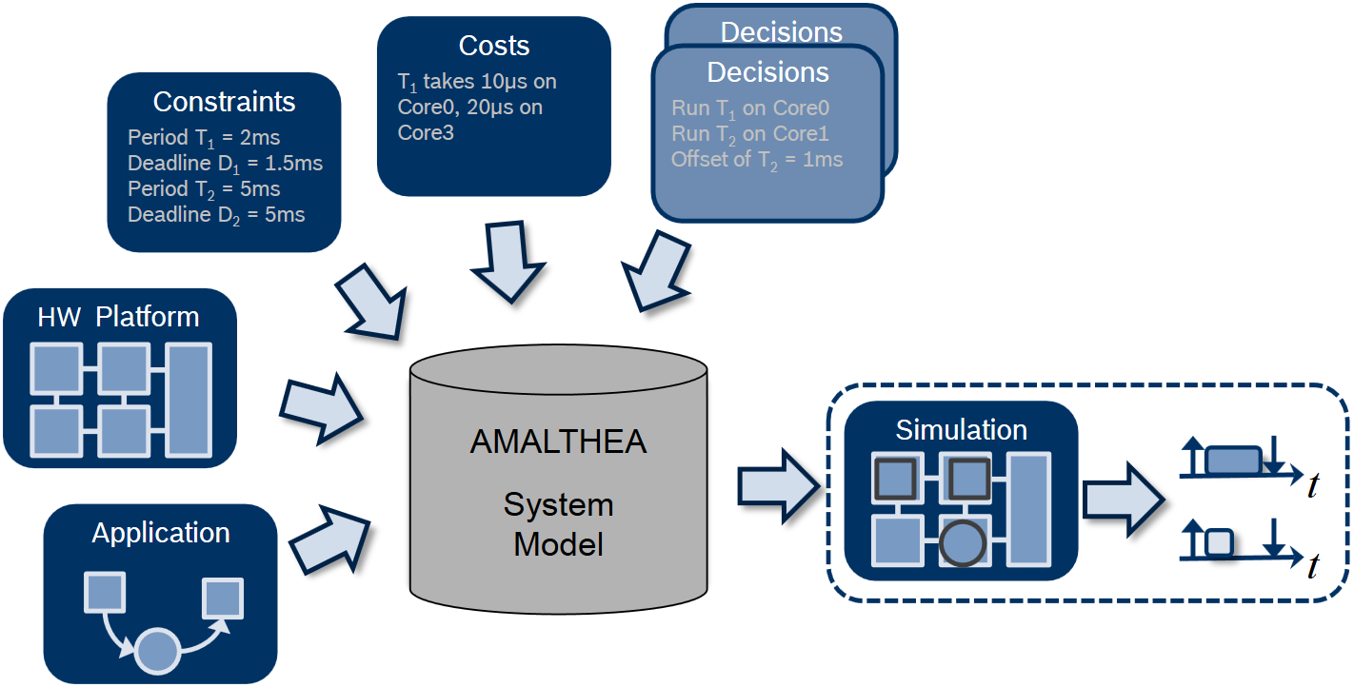
APP4MC
Modeling
E.M.F., AMALTHEA model

Slide 41
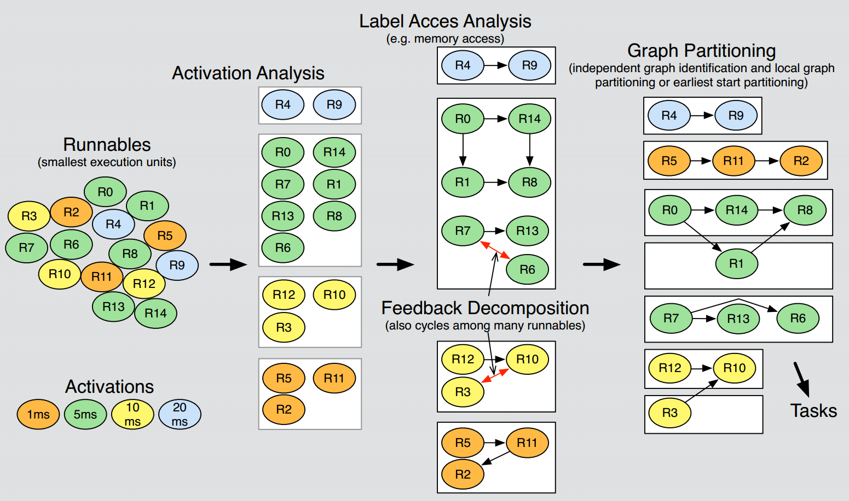
APP4MC
Partitioning based upon Graph Theory
(image from Robert Höttger, ESM DPS WS 2015/2016, FH Dortmund)

Slide 42



APP4MC
Partitioning
Options: ESSP, CPP
ESSP:
Greedy algorithm.
Nodes assigned to a task that minimizes overall schedule length.
CPP:
Identifies CP first.
Then assigns tasks afterwards to an unbounded number of tasks.
(images from Robert Höttger, ESM DPS WS 2015/2016, FH Dortmund)
Notes:
ESSP is a Greedy algorithm. The algorithm considers more, but basically minimizing SLR is correct. Is *bounds* the number of tasks.
CPP indentifies CP first and assigns tasks afterwards to an *unbounded* number of tasks. _tf_ calculation is necessary to retain all (or not violate any) order precedences.

Slide 43

APP4MC
Mapping
Allocation of
Tasks to cores
Data and labels to memory
Options:
ILP-based, GA-based load balancing
Goals:
Reducing computation time (main concern)
Optimization towards energy consumption
Upcoming Features (after version 0.8.1)
Load-balancing algorithms (GA)

Slide 44

Design and Implementation of A4MCAR
Development Workflow
Open-source development workflow for A4MCAR
http://mozcelikors.github.io/a4mcar

Slide 45





Design and Implementation of A4MCAR
Overall Look to A4MCAR
Safety Considerations
Isolated Boards and Motors
Emission-compliant Isolator
circuit
Voltage Shifters (3V<-> 5V)
Safe braking using Relays

Slide 46

Design and Implementation of A4MCAR
Overall Look to A4MCAR
Hardware Schematics

Slide 47


Design and Implementation of A4MCAR
How does Infrastructure look like?
xCORE-200 16-core microcontroller
XMOS / xTIME Scheduler
Round robin
Tile 0
Tile 1
xTIME Composer

Slide 48


Design and Implementation of A4MCAR
How does Infrastructure look like?
Raspberry Pi (Raspbian/Linux)
GNU/Linux Architecture
Process/Thread Lifecycle
Completely Fair Scheduling
(CFS)
(not Real-Time due to
Equal time slices)

Slide 49

Design and Implementation of A4MCAR
How does Infrastructure look like?
Raspberry Pi (Raspbian/Linux)
Developing in Raspberry Pi
SSH connection from PC
PuTTy (Shell)
TightVNC (Desktop)
Eclipse IDE (Remote Compilation/Debugging)
Editors
Any GNU/Linux Terminal software
Eclipse IDE
Emacs (Powerful dev. Env.)

Slide 50




Design and Implementation of A4MCAR
Low-level Module Tasks
Acceleration/Braking
PWM-based ESC drive
Timer event in XMOS
20ms pulse period
Relay-based braking

Slide 51

Design and Implementation of A4MCAR
Low-level Module Tasks
Steering
Servo motor
Driven with PWM pulse
Timer event in XMOS
20ms pulse period
1-1.5ms -> Left side
1.5ms-2.0ms -> Right side

Slide 52

Design and Implementation of A4MCAR
Low-level Module Tasks
Acceleration (PWM)
Braking (RelayCtrl/I-O)
Steering (PWM)
Proximity Sensing (I2C, SRF-02)
VCC
GND
SDA
SCL

Slide 53
Design and Implementation of A4MCAR
Low-level Module Tasks
Proximity Sensing
SRF-02 Ultrasonic Sensor
I2C network with 4 sensors
Voltage-shifted
VCC
GND
SDA
SCL

Slide 54
Design and Implementation of A4MCAR
Low-level Module Tasks
Bluetooth Task
RN-42 Bluetooth module
Communicates using UART

Slide 55

Design and Implementation of A4MCAR
Low-level Module Tasks
TCP Server Task
Many concurrent tasks implement PHY driver and TCP protocol

Slide 56
Design and Implementation of A4MCAR
Low-level Module Tasks
Core Monitoring Task
Instantiated for two seperate tiles.
Timer event polls internal registers for each core to see if cores are busy
Averaging over time gives reasonable core util information
Counters for busy and idle cycles are used.

Slide 57

Design and Implementation of A4MCAR
High-level Module Tasks
Overview
Schedulability and traceability (of apps)

Slide 58
Design and Implementation of A4MCAR
High-level Module Tasks
Core Reader
Uses 3rd party: ‘psutil’ package from
Python
Logs each core utilization
TCP Client
Uses Python’s ‘socket’ library
Transmission & reception

Slide 59

Design and Implementation of A4MCAR
High-level Module Tasks
3. Web Server (apache2)
Deliver & process HTTP requests
HTML, CSS, JavaScript – based web pages
PHP-based server pages and databases

Slide 60
Design and Implementation of A4MCAR
High-level Module Tasks
Web Front-End Design and Implementation
Technologies Used: HTML, CSS, PHP, JavaScript, AJAX, jQuery, Python

Slide 61

Design and Implementation of A4MCAR
High-level Module Tasks
Web Server (apache2)
Controlling A4MCAR via Web interface
Displaying core utilization (jqPlot)
Camera Streaming
mjpg_streamer

Slide 62

Design and Implementation of A4MCAR
High-level Module Tasks
4. Camera Streaming
mjpg_streamer
Experimental streaming for Raspicam
Resolution: 640 x 480, Fps : 30

Slide 63

Design and Implementation of A4MCAR
High-level Module Tasks
Dummy Loads
Random matrix multiplication 1000 x 1000
Different task periods 0.5s to 1.4s

Slide 64


Design and Implementation of A4MCAR
High-level Module Tasks
Image Processing
C++, OpenCV 2.6
Traffic Cone Detection
Based on contour detection
Threshold + Background Subtraction + Edge Detection

Slide 65
Design and Implementation of A4MCAR
High-level Module Tasks
Touchscreen Display
Waveshare 5” 800x480 HDMI+SPI
Python’s pygame framework used.
Multi-threaded design for touchscreen event
responsiveness.

Slide 66


Efforts Toward Tracing
XMOS’s XTA Tool for Binary Analysis
To get granularity information for AMALTHEA
Non-deterministic tasks are left unexamined.
We check disassembly in that case.

Slide 67
Efforts Toward Tracing
Linux’ perf for Dynamic Analysis of Instructions and Traces
Perf: Performance analysis tool
Able to statisically profile entire system or individual processes
Able to dynamically count instructions as program executes
Able to hide overhead as much as possible
Installing perf
apt-get install linux-tools
Functions used in A4MCAR:
Getting granularity of processes
sudo perf stat –e instructions:u –p <pid>
sudo perf stat –e instructions:u –p <pid> --sleep <timeout>
Getting granularity of threads
Sudo perf stat –e --per-thread –e instructions:u –p <pid> -I <timeout>
Recording system traces
sudo perf sched record -- sleep <timeout>
Showing system traces
sudo perf sched script > trace.txt
Sudo perf sched map > trace.txt

Slide 68

Efforts Toward Tracing
Linux’ perf for Tracing
sudo perf sched script > trace.txt

Slide 69

Efforts Toward Tracing
Linux’ perf for Tracing
sudo perf sched map > trace.txt
CPU0
CPU1
CPU2
CPU3
(*: Context switch, migration)

Slide 70

Efforts Toward Tracing
Visualizing perf traces
Common Trace Format (CTF)
Built new linux-tools from a custom Linux kernel source
Built perf with libbabeltrace
perf.data >> ./ctf
Eclipse TraceCompass
Custom scripts

Slide 71

Efforts Toward Software Distribution
In XMOS (xC)
at compile-time
In Linux
At runtime
(combinable tasks)
Class
‘aprocess’
For processes and threads
taskset –pc <coreaffinity> <pid>
To handle
bash and python scripts execute functions.
Executes
taskset
[COREDEF_LIST_APP4MC] Assign Task Xtightvnc To Core 0 Assign Task mjpg_streamer To Core 0 Assign Task touchscreen_display To Core 0 Assign Thread Thread_UpdateCoreUsageInfo To Core 2 ....
Main
Process
.a4p file

Slide 72
Results
Low-Level Module Results
Evaluation goal: To fit xCORE applications into APP4MC scope
Parallelization goal = # of cores required exceeded.
Approach = periodic tasks are distributed, sporadic tasks are left undistributed.
For evaluation GET and STavg is calculated, Avg.Util is observed.
For XMOS, APP4MC model needs to be constrained.
i.e. Sporadic tasks are not distributed.
i.e. Functional runnables need to be grouped together.
Otherwise the functionality issues are observed in the distribution execution.
Constrained model gave better timing performance.
Stability problems
Notes:
Evaluation goal: To fit xCORE applications into APP4MC scope
Parallelization goal = # of cores required exceeded.
Approach = periodic tasks are distributed, sporadic tasks are left undistributed.
For evaluation GET and STavg is calculated, Avg.Util is observed.
For XMOS, APP4MC model needs to be constrained.
i.e. Sporadic tasks are not distributed.
i.e. Functional runnables need to be grouped together.
Otherwise the functionality issues are observed in the distribution execution.
Constrained model gave better timing performance.

Slide 73

Results
High-Level Evaluation
ESSP, 10 partitions, GA

Slide 74
Results
HL Evaluation Methodology
Evaluation Goal: To compare APP4MC with OS-based performance
Four distributions are created and evaluated, each having different set of processes and threads.
Core-affinities are compared: OS, Sequential, APP4MC
Evaluation metrics involve: STavg, GET, DLM, U, IDD
Observed Results
In three distributions, timing performance OS > APP4MC > Sequential
In one distribution, APP4MC > OS > Sequential
So, achieving better performance with APP4MC is possible, but not guaranteed.
APP4MC results improve power cons. very slightly as opposed to OS.
Lesser context-switching in APP4MC.
OS-based distribution involves fluctiations in power consumption.
Power cons. (Underclocking + Downvoltage) > (Undercloking only)
Huge stability problems in Sequential distribution
Reasoning

Slide 75
Conclusions
Reasoning & Conclusion
A4MCAR has its limitations,
System overheads, profiling overheads, non-exact model, not-so fine-grained runnables.
APP4MC is real-time and ensures causal order.
CFS -> very fair, therefore non real-time.
Using RT patch (preemptRT) in Linux is a solution.
Also, OS does not ensure causal order.
APP4MC targets model-based development for industry applications.
Static scheduling is not the best way to approach Linux systems without low-level RTOS solns.
APP4MC targets more fine-grained, lower-level, higher-scale systems.
In our app, we use process/threads as runnables.
APP4MC’s partitioning only concerned about load-balancing when activation periods are the same.
APP4MC is in development stage,
Non dependency-dependent algorithms are being developed.
N-stage genetic algorithms are being studied for load balanding (as opposed to willy nilly distr.)
Not able to work when threads are sporadically activated.
APP4MC focuses on ideal vision of embedded computing
Automizing parallelization foundations based on model-driven manner, using static scheduling approaches.
To get rid of the non-determinism in parallelization, power consumption.
For more industry applications.
APP4MC is a suggestive, supplementary tool.

Slide 76
Final Words
This work, (A4MCAR, APP4MC)
follows pure open-source development workflow. ( under Google Inc, Eclipse Foundation )
develops certain applications as a demonstrator.
implements necessary tool support for analysis and tracing of applications for APP4MC.
evaluates APP4MC performance and compares it to OS-based performance.
Succeeding work, (APP4MC Rover, APPSTACLE)
extends applications toward Cloud & IoT interaction and services.
uses industry-type automotive OS & HMI.
uses more well-engineered software infrastructure (more homogeneous & fine-grained).

Slide 77
Unresolved Bug: Why Core Utilization Display is Not Reasonable on Low-level Module?
The approach used is only working for certain periodic tasks.
This approach is proposed in XMOS website.
Complexity is high in A4MCAR c.t XMOS-modules.
Therefore, this is a still unresolved bug for XMOS.

Slide 78
Unresolved Bug: Light System Modes
Possible hardware fault or
incompatible motor driver.

Slide 79
Why: Not Use Real-time Kernel
By the time of this discovery, applications were ready.
Due to the complexity of the topic,
and choosing complex applications that are harder to port.
This approach is subject to,
1) Further Work
2) and maybe Another Academic Research

Slide 80
Why: Not Have Lower-Grained Applications
Higher-level, higher grained applications are chosen
Due to,
Distribution efforts of runnables are effortful
Maybe subject to another thesis
Only Industry-level tools allow fine-grained modular apps
to be distributed and arranged

Slide 81
Term Sheet
Runnable: Does not depend on each other
Task: Has Shared memory
Thread: Has Virtual address space
Process: Has Local (own) memory
Race Condition: Output depends on sequence of uncontrollable events
Mutex: Critical section is written exclusively
Semaphore: Access of multiple processes to a resource controlled.
Load balancing: Ensures reduced power cons due to high slack time.
Min.comp time: Ensures higher timing performance.

Slide 82



Slide 83


Slide 84


Slide 85


